Slide 1
Software Basics 1
Guangjian Zhou

Slide 2
What is SDLC
The software development lifecycle (SDLC) is the cost-effective and time-efficient process that development teams use to design and build high-quality software. The goal of SDLC is to minimize project risks through forward planning so that software meets customer expectations during production and beyond. This methodology outlines a series of steps that divide the software development process into tasks you can assign, complete, and measure.

Slide 3
What is Waterfall.
The Waterfall methodology — also known as the Waterfall model — is a sequential development process that flows like a waterfall through all phases of a project (analysis, design, development, and testing, for example), with each phase completely wrapping up before the next phase begins.
Each phase depends on the outcome of the previous phase.
this model doesn’t work well when flexibility is a requirement. There is little room for change once a phase is deemed complete, as changes can affect the cost, delivery time, and quality of the software.

Slide 4
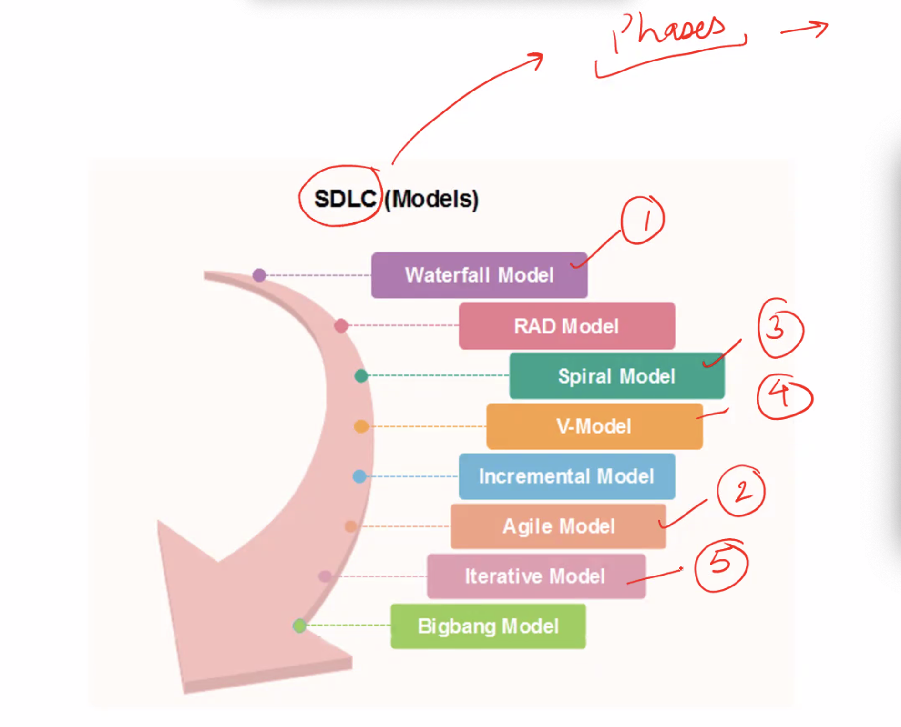
Different Models under SDLC

Slide 5
Different Models under Agile.
There are 5 main Agile methodologies: Scrum, Kanban, Extreme Programming (XP), Lean Development e Crystal.

Slide 6
What is UML
Unified Modeling Language (UML) is a general purpose modelling language. The main aim of UML is to define a standard way to visualize the way a system has been designed. It is quite similar to blueprints used in other fields of engineering.
UML is not a programming language, it is rather a visual language. We use UML diagrams to portray the behavior and structure of a system. UML helps software engineers, businessmen and system architects with modelling, design and analysis. The Object Management Group (OMG) adopted Unified Modelling Language as a standard in 1997. Its been managed by OMG ever since. International Organization for Standardization (ISO) published UML as an approved standard in 2005. UML has been revised over the years and is reviewed periodically.

Slide 7
What is Architiecture Diagram for Project.
An architecture diagram is a visual representation of all the elements that make up part, or all, of a system. Above all, it helps the engineers, designers, stakeholders — and anyone else involved in the project — understand a system or app’s layout.

Slide 8
What is Deployment Phase in SDLC
The deployment phase is the final phase of the software development life cycle (SDLC) and puts the product into production. After the project team tests the product and the product passes each testing phase, the product is ready to go live. This means that the product is ready to be used in a real environment by all end users of the product.
There are various phases of the deployment process the project team must follow to ensure the code and technology deploy appropriately. The phases include deployment preparation and procedures, product deployment, transferring ownership of the product, and closing the deployment phase. Let's learn about each phase in more detail.

Slide 9
What do you mean by Sprint in Agile Scrum.
A sprint is a short, time-boxed period when a scrum team works to complete a set amount of work. Sprints are at the very heart of scrum and agile methodologies, and getting sprints right will help your agile team ship better software with fewer headaches.
“With scrum, a product is built in a series of iterations called sprints that break down big, complex projects into bite-sized pieces," said Megan Cook, Group Product Manager for Jira Software at Atlassian.

Slide 10
ER diagram ?
An Entity Relationship (ER) Diagram is a type of flowchart that illustrates how “entities” such as people, objects or concepts relate to each other within a system. ER Diagrams are most often used to design or debug relational databases in the fields of software engineering, business information systems, education and research. Also known as ERDs or ER Models, they use a defined set of symbols such as rectangles, diamonds, ovals and connecting lines to depict the interconnectedness of entities, relationships and their attributes. They mirror grammatical structure, with entities as nouns and relationships as verbs.

Slide 11
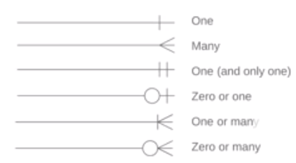
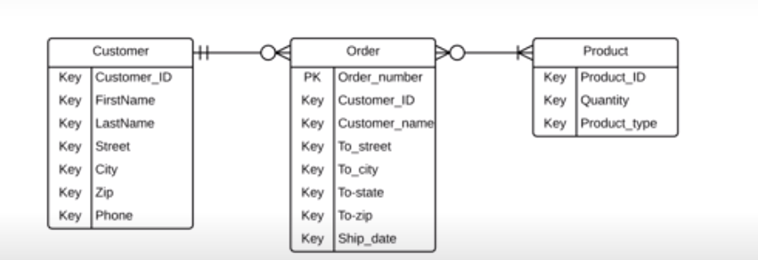

Slide 12
Difference between Waterfall and Agile Methodology.
Waterfall
Waterfall represents the oldest, simplest, and most structured methodology. Each phase depends on the outcome of the previous phase, and all phases run sequentially. This model provides discipline and gives a tangible output at the end of each phase. However, this model doesn’t work well when flexibility is a requirement. There is little room for change once a phase is deemed complete, as changes can affect the cost, delivery time, and quality of the software.
Agile
The agile methodology produces ongoing release cycles, each featuring small, incremental changes from the previous release. At each iteration, the product is tested. The agile model helps teams identify and address small issues in projects before they evolve into more significant problems. Teams can also engage business stakeholders and get their feedback throughout the development process.

